Slide 1

Ethical Hacking Internship Task - 2
Report By: Rashmi Dewangan

Slide 2
Introduction
This is the vulnerability assessment and penetration testing (VAPT) report for the given website-
http://testasp.vulnweb.com
I have reported all the vulnerabilities found on this website with their screenshots and links.
I have also provided business risks and expert recommendations to tackle those vulnerabilities.

Slide 3
Cross Site Scripting
Domain: vulnweb.com
Subdomain: testasp.vulnweb.com
Payload: <script>alert(1)</script>
Vulnerability Type: Severe

Slide 4
Steps to Reproduce
Visit the website – http://testasp.vulnweb.com
On the top menu find a search option.
Click on it and it will be prompted with the search box.
Try the XSS script <script>alert(1)</script> in search box and click search.
It works and gives out a response to script injection.

Slide 5
Intercept the request in Burp Suite.
Now find different payloads for XSS.
Send the request to intruder, paste all the payloads and start attack.
Check which XSS script intruded, copy the response of it and paste it in Firefox browser to see how it works.
Try to find a successful payload for XSS.

Slide 6
Impact
The impact of Cross-Site Scripting can be significant, leading to various security risks and potential consequences:
Data Theft
Session Hijacking
Phishing Attacks
Malicious Actions on Behalf of the User
Defacement of Websites
Spread of Worms
Loss of Trust

Slide 7
Mitigation
To mitigate the impact of Cross-Site Scripting, it is essential for developers to implement secure coding practices, validate and sanitize user inputs, and employ mechanisms such as Content Security Policy (CSP) to reduce the risk of XSS attacks.
Regular security audits and penetration testing are also crucial to identify and address vulnerabilities before they can be exploited by attackers.

Slide 8
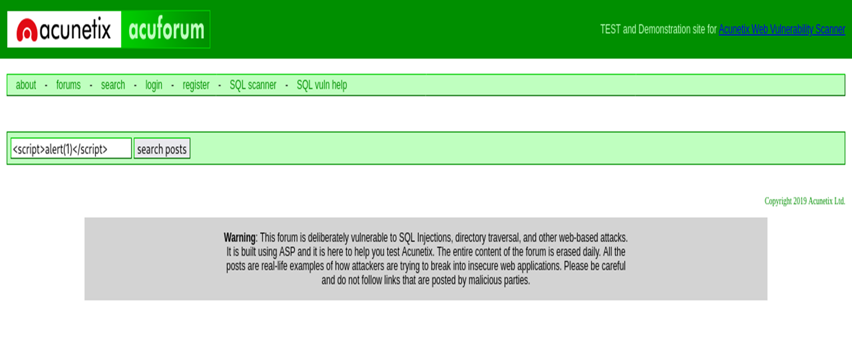
POC including screenshot/screen recording is included in the report which is attached below:

Slide 9
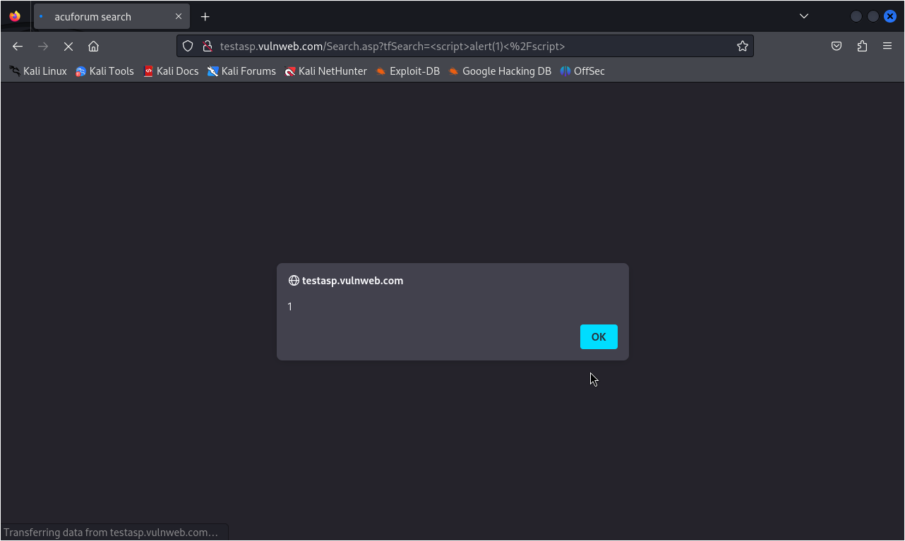

Slide 10
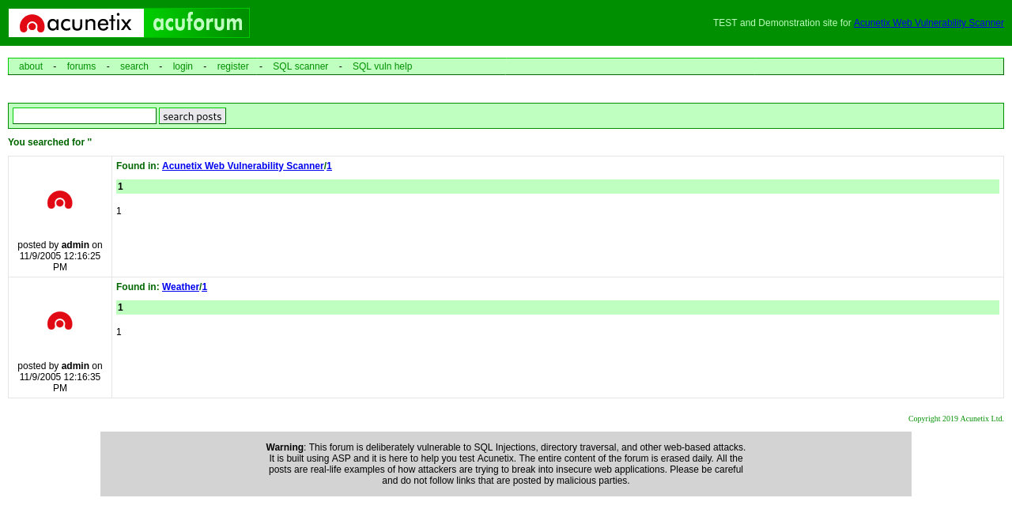

Slide 11
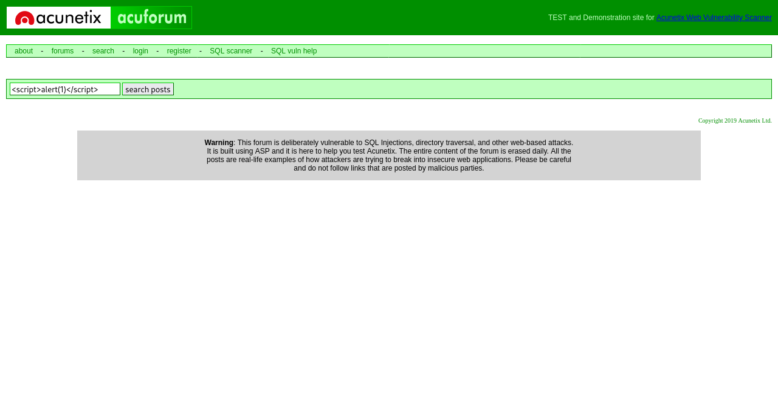

Slide 12
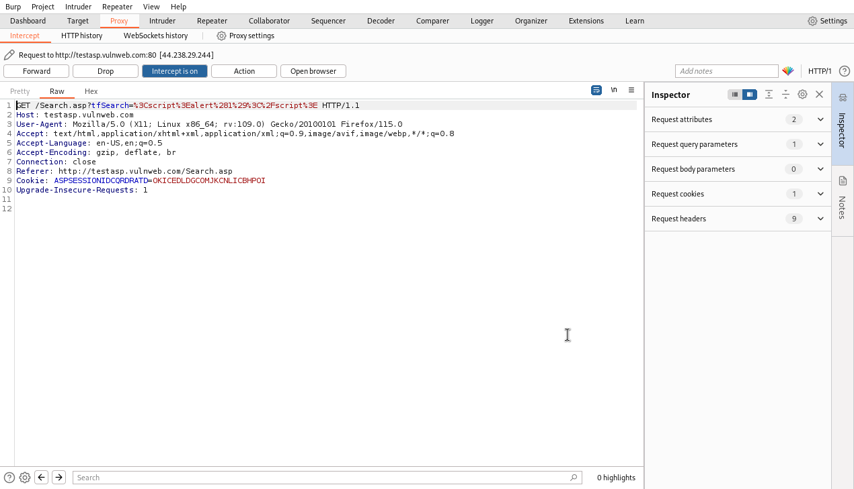

Slide 13
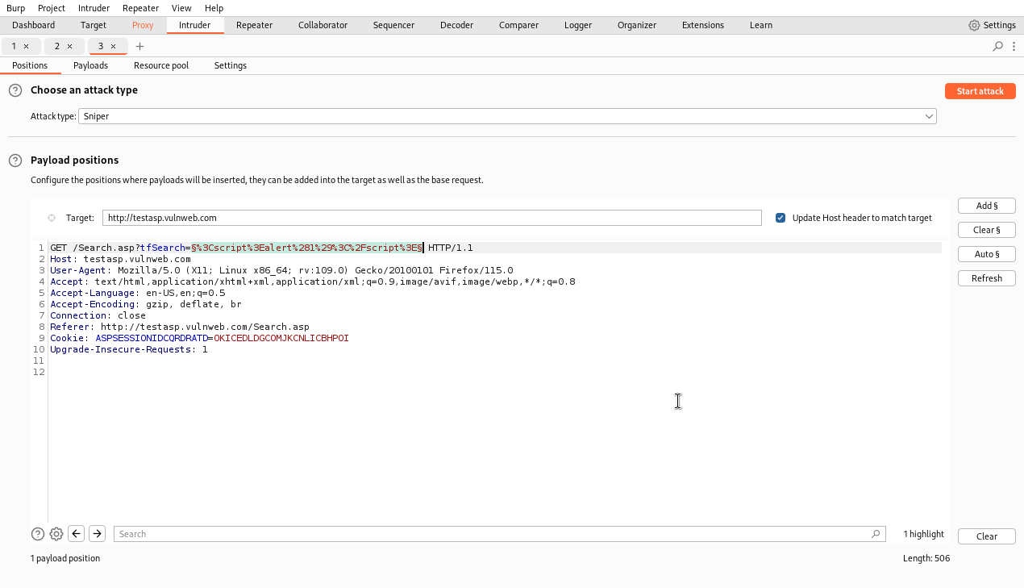

Slide 14
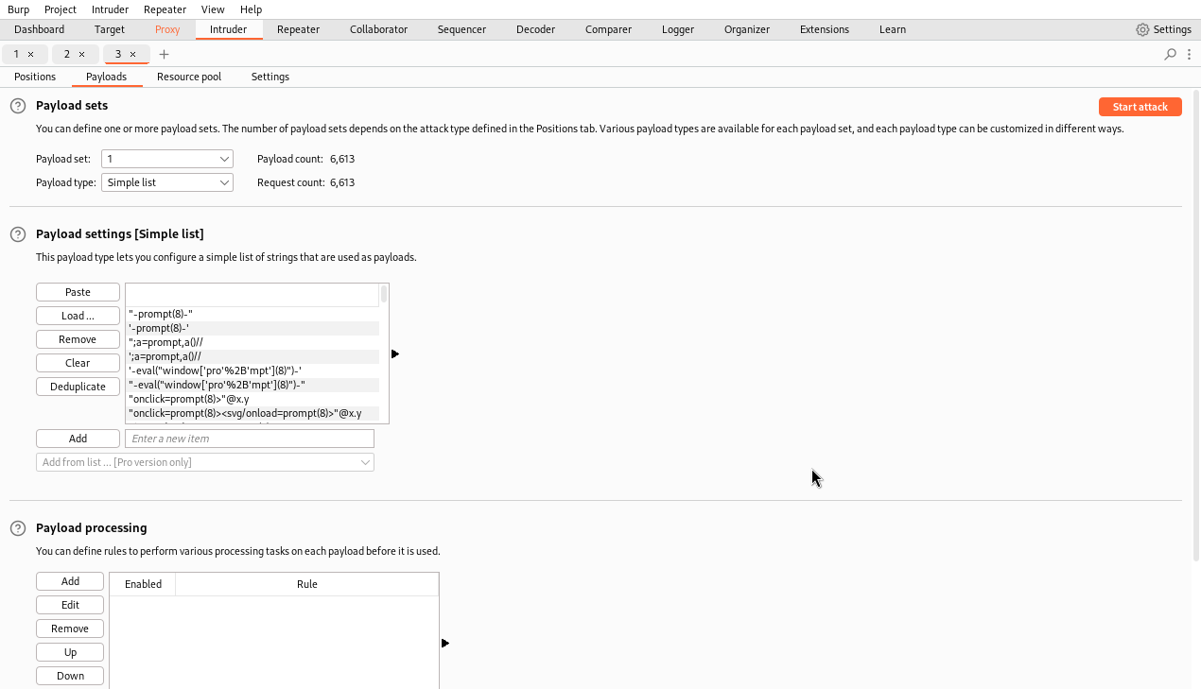

Slide 15
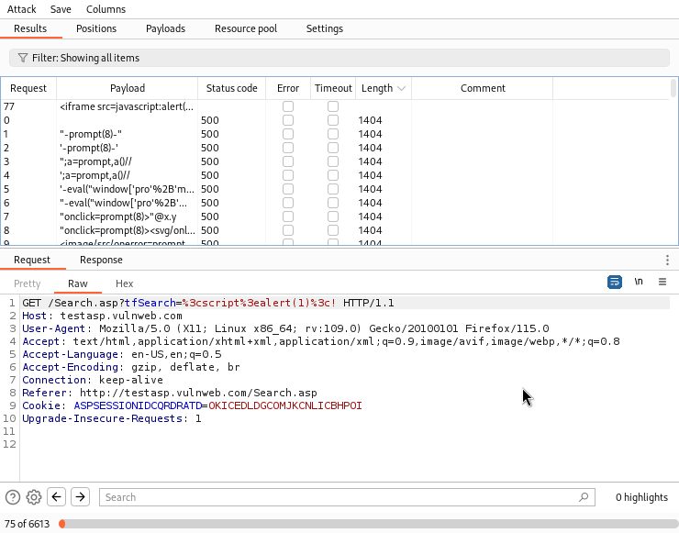

Slide 16
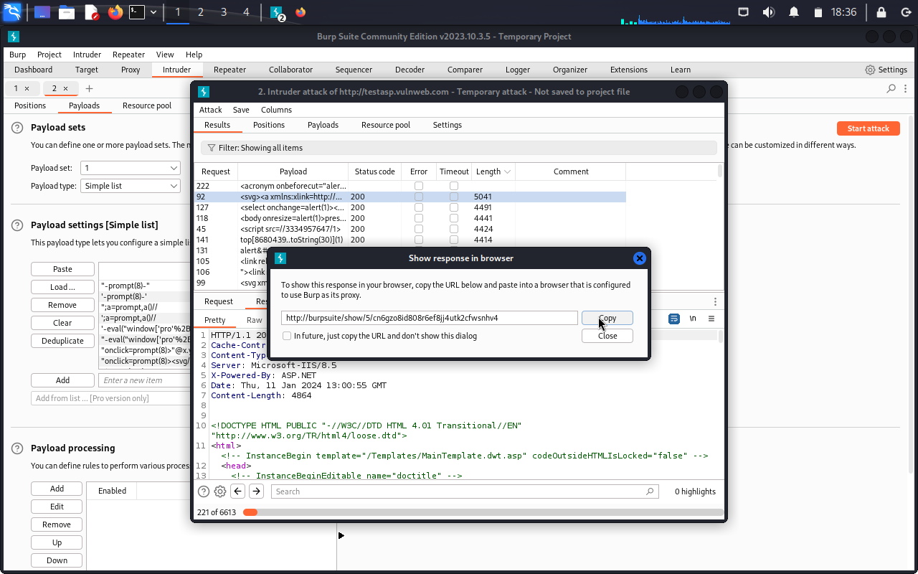

Slide 17
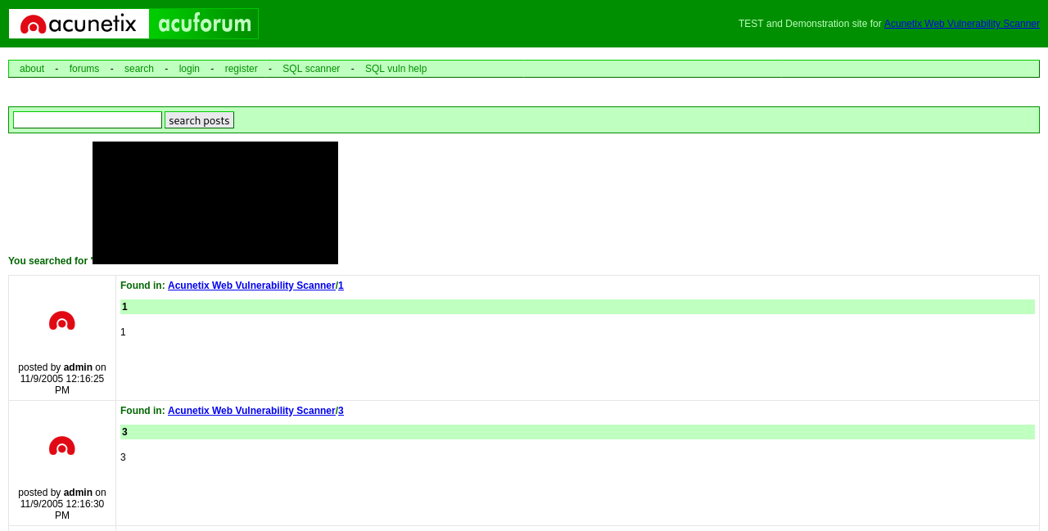

Slide 18
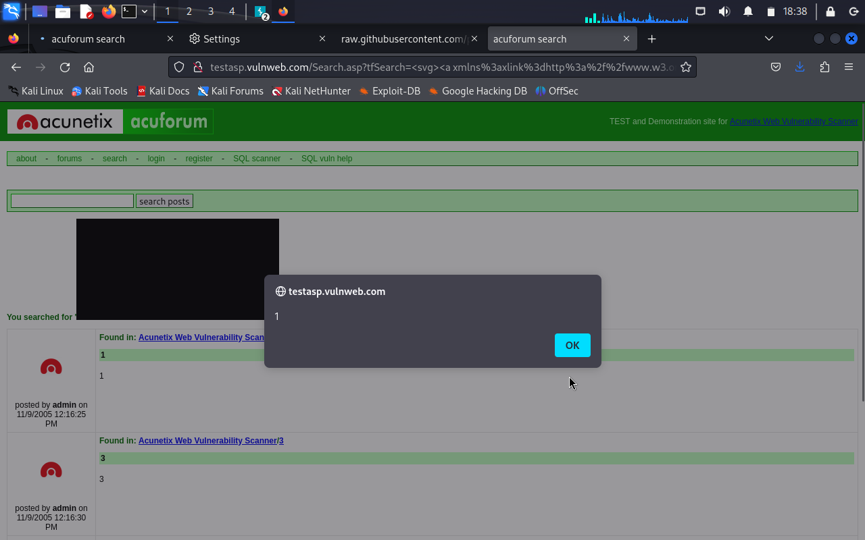

Slide 19
THANK YOU For any further clarifications, please contact: rdew24@gmail.com

